Slide 1
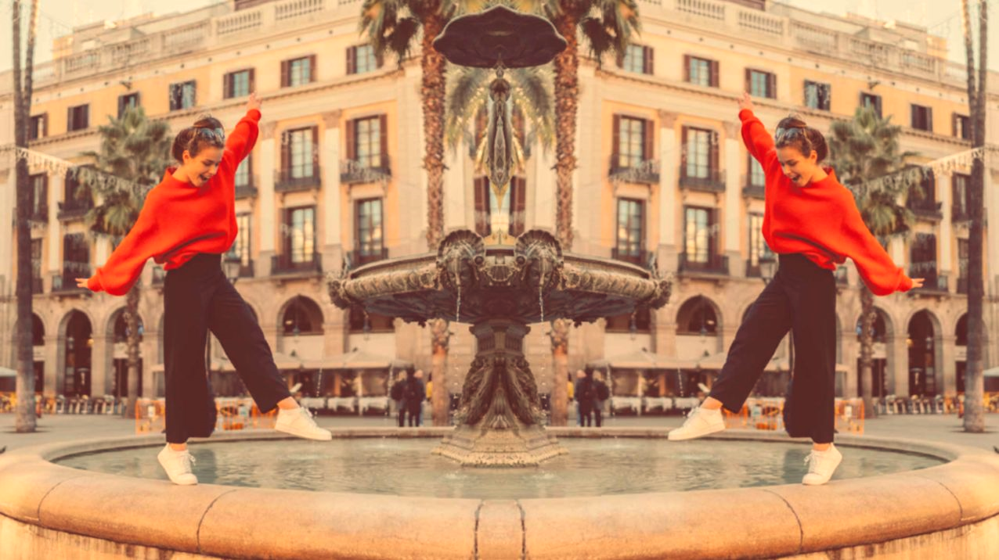
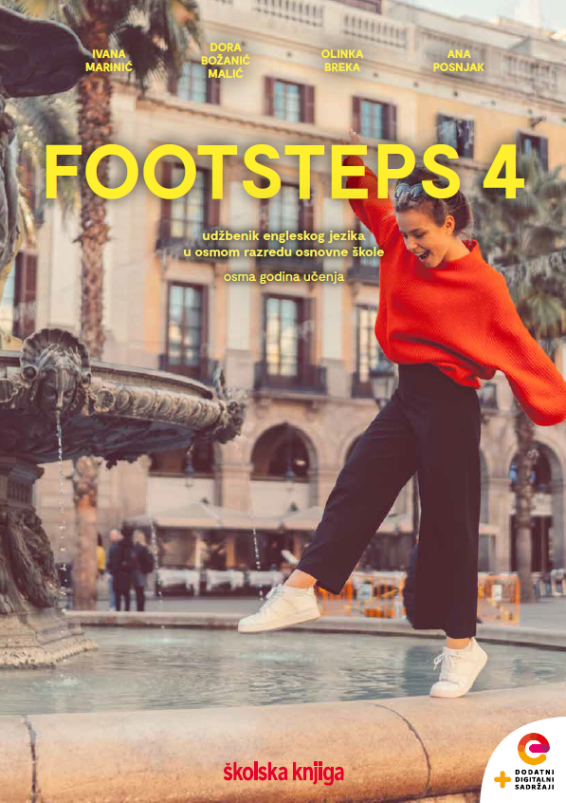

UNIT 5; Tick tock
Lesson 3; Time to vote

Slide 2
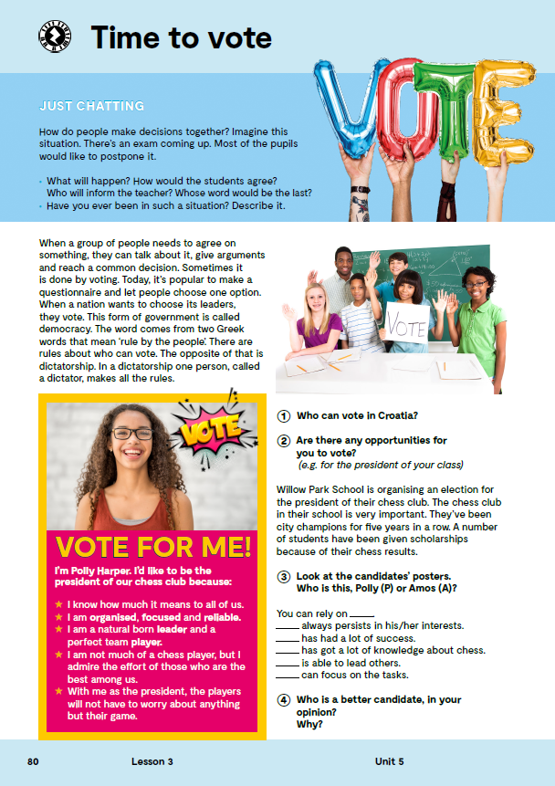
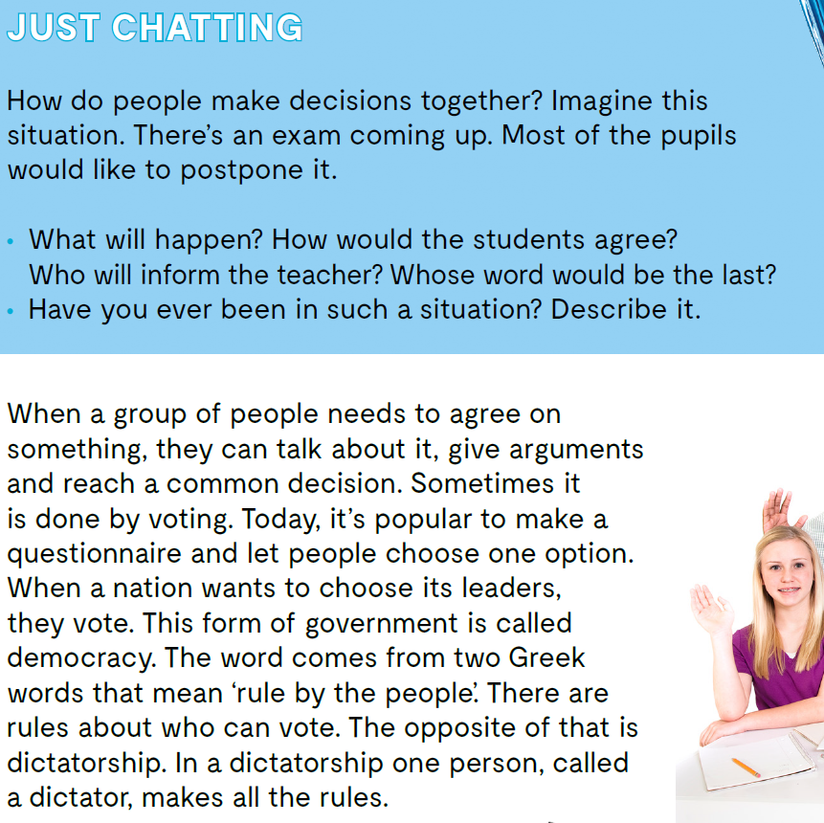

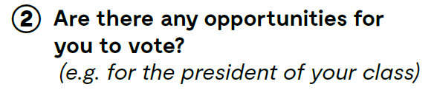
Read the text about voting.
Do you know the meaning of these expressions?
voting
election
democracy
dictatorship
persistent
knowledgeable
glasanje
izbori
demokracija
diktatura
uporan
obrazovan
Who can vote in Croatia?
Are there any opportunities for you to vote?

Slide 3

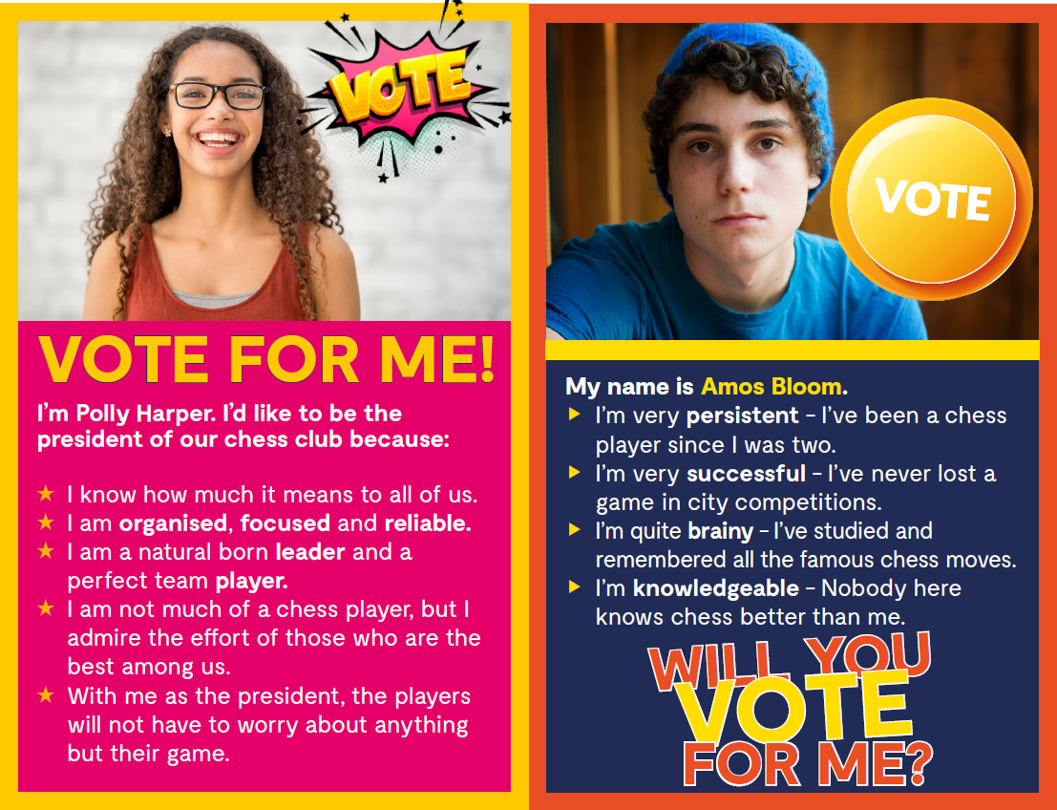
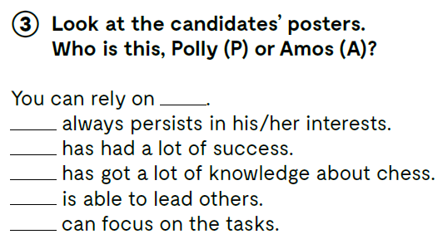
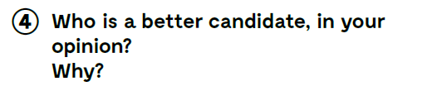
Look at the candidates’ posters. Who is this, Polly (P) or Amos (A)?
P
A
A
A
P
P
Who is a better candidate, in your opinion? Why?

Slide 4
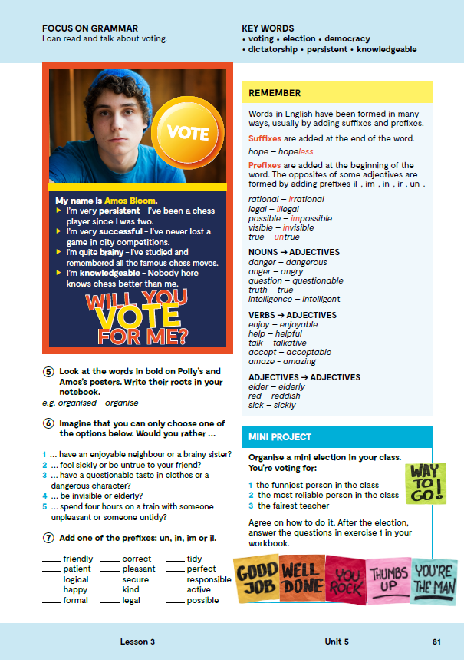
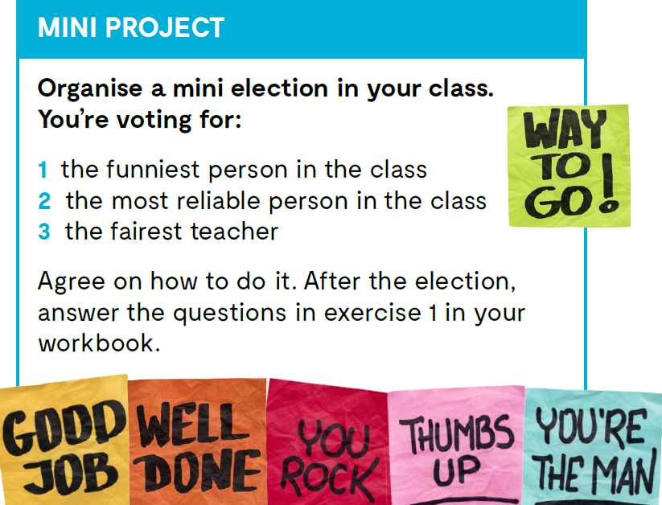

Slide 5
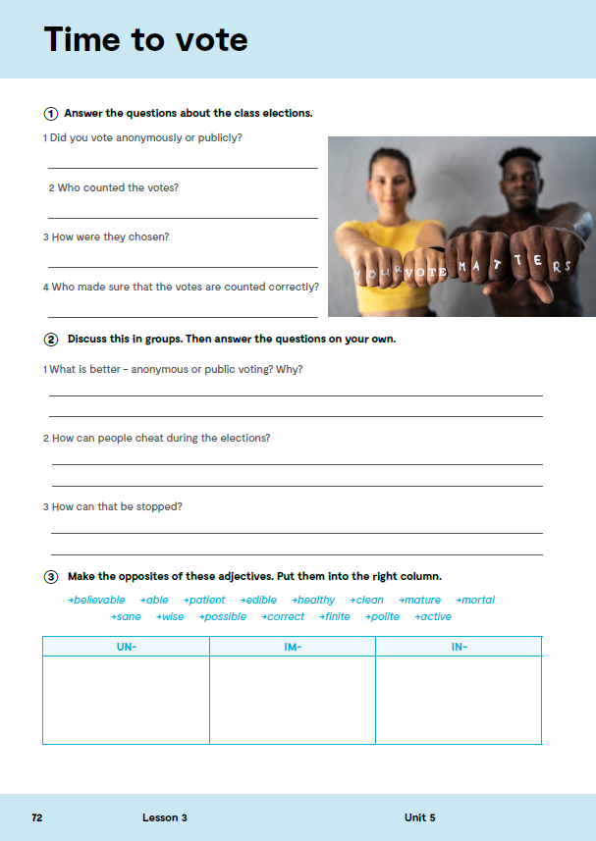
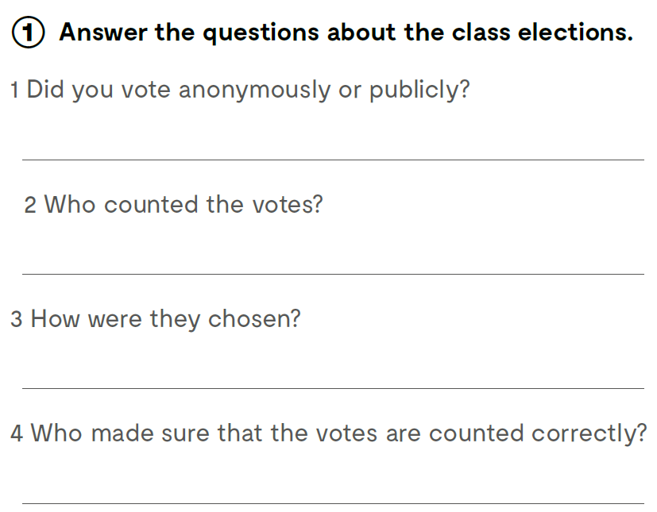
Workbook, page 72.

Slide 6

Open the following link and then click on LEARN MORE! https://www.e-sfera.hr/dodatni-digitalni-sadrzaji/d8456ba3-735e-48d9-9dc3-845a080f2b41/
Elephants and donkeys
Read the texts and do the tasks bellow the text. Pročitaj tekstove i riješi zadatke ispod teksta.

Slide 7
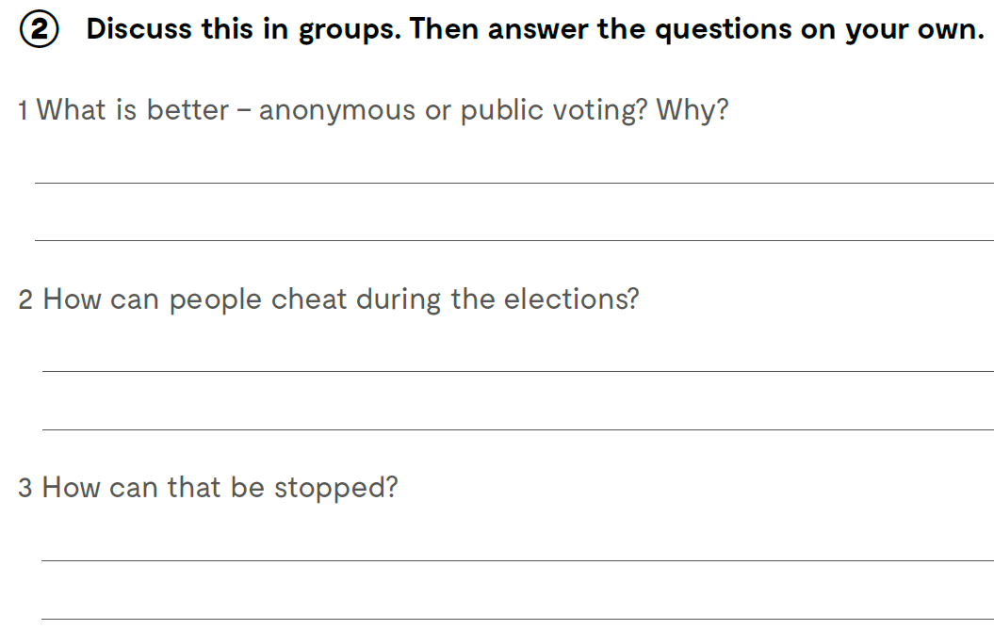
Think about these questions..

Slide 8

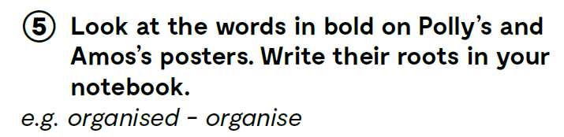
Look at the words in bold on Polly’s and Amos’s posters. Write their roots in your notebook.
focused – focus
reliable – rely
leader – lead
player – play
persistent – persist
successfull – success
brainy – brain
knowledgeable – knowledge

Slide 9
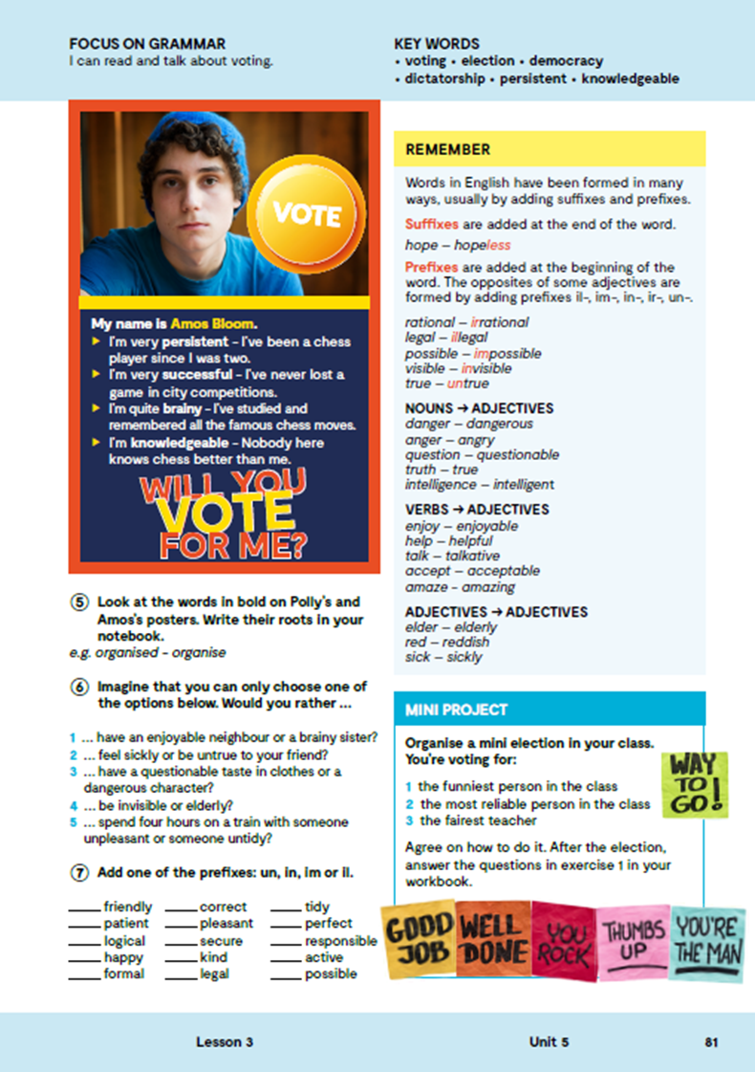
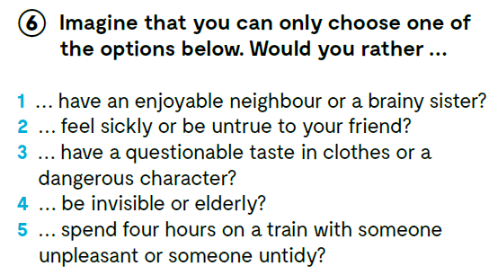
Imagine that you can only choose one of the options below. Would you rather …

Slide 10

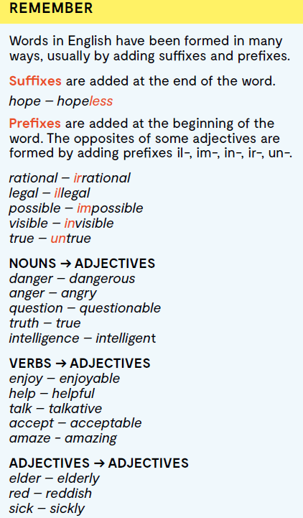
Suffixes tj. nastavke dodajemo na kraju riječi: hope – hopeless
Prefixes tj. predmetke dodajemo na početku riječi. Suprotne pridjeve dobivamo dodavanjem predmetka il-, im-, in-, ir-, un-. rational – irrational legal – illegal possible – impossible visible – invisible true – untrue
IMENICA → PRIDJEV danger – dangerous anger – angry question – questionable truth – true intelligence – intelligent
GLAGOL → PRIDJEV enjoy – enjoyable help – helpful talk – talkative accept – acceptable amaze – amazing
PRIDJEV → PRIDJEV elder – elderly red – reddish sick – sickly

Slide 11
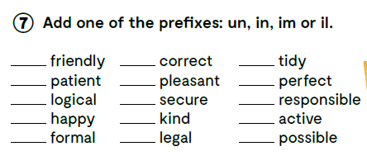
Add one of the prefixes: un, in, im or il.
un
in
un
im
un
im
il
in
ir
un
un
in
in
il
im
Check what you have learnt. https://wordwall.net/play/13078/369/776
https://www.bookwidgets.com/play/RB99HR5

Slide 12
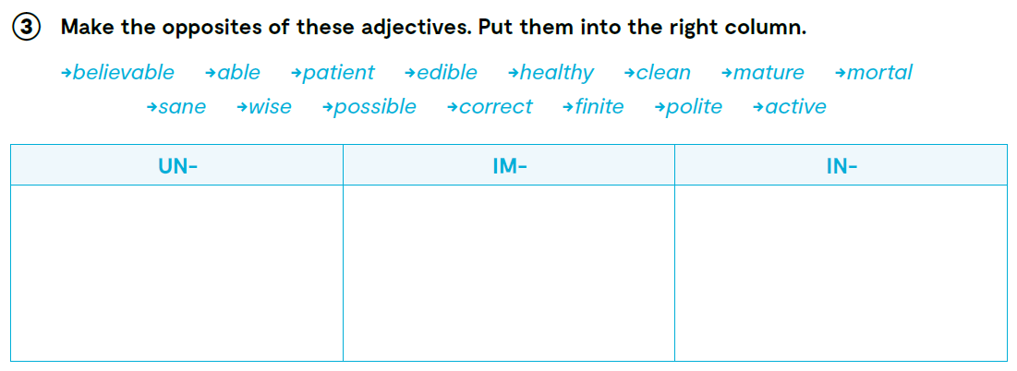
workbook, page 72.
unbelievable
unable
impatient
inedible
immature
immoral
insane
unhealthy
unclean
incorrect
infinite
impossible
unwise
impolite
inactive

Slide 13
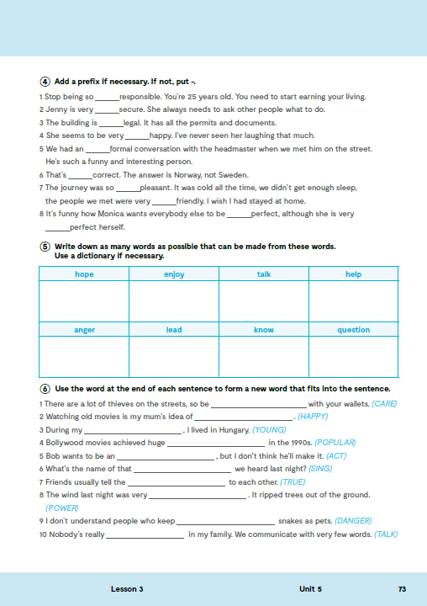
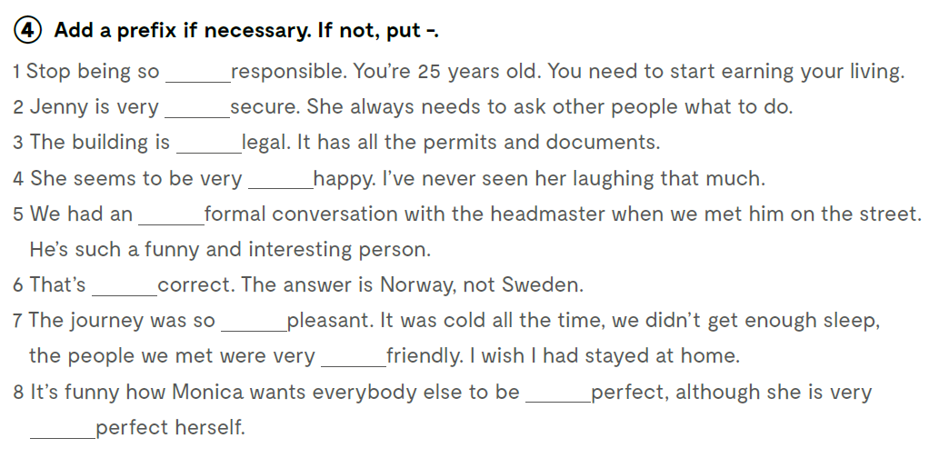
ir
in
-
-
in
in
un
un
-
im

Slide 14
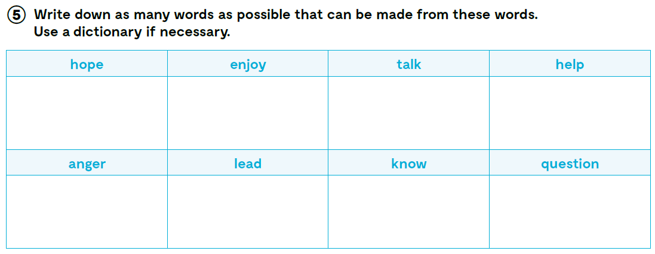
hopeful
hopefully
hopeless
hopelessness
…
enjoyment
enjoyable
unenjoyable
…
talkative
untalkative
uptalk
…
helpful
unhelpful
helpless
helping
…
angry
angrily
to anger
…
leader
leadership
leading
…
knowledge
knowledgeable
known
unknown
…
questionable unquestionable
questionnaire
…

Slide 15
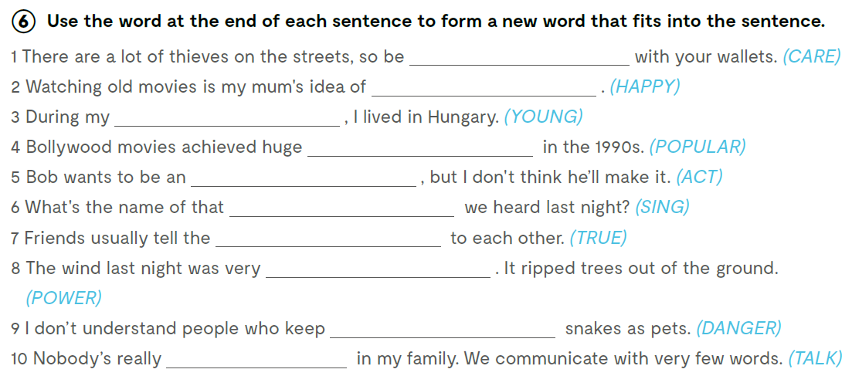
careful
happiness
youth
popularity
actor
song
truth
powerful
dangerous
talkative

